Slide 1
Salesforce Data Archival Strategy - Bibin Viyyath

Slide 2
Agenda
Agenda
Data Archival Need
Data Archival Strategy
App Exchange Products
Demo

Slide 3

Data Archival Need

Slide 4
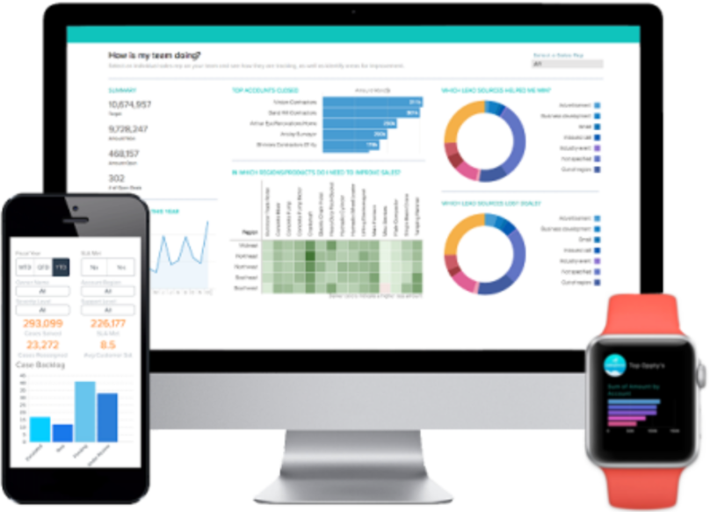
Data Archival Need
Data Archival Need |
Data Archival Strategy |
App Exchange Products |
Demo |
1
Increased Data Volume can hamper performance by slowing down query response time and thereby impacting User Experience
2
Archived Data can be used as a backup in case of data losses due to migration, inconsistent data governance, misplaced integration touchpoints.
3
Data consolidation improves user proficiency of the system as they have lesser data to manage.
4
Archiving and retiring legacy production data results in reduced storage costs.
5
Regulatory compliances in most industries dictate data retention. As Data storage in Salesforce comes with a cost, archival would ensure compliance as well as reduced cost.
6
Data Archival allows business to retail all data, without the need to consider what should go, thereby allowing future access to all data.

Slide 5
Data Archival Strategy

Slide 6
Data Archival 4-Point Strategy
Data Archival Need |
Data Archival Strategy |
App Exchange Products |
Demo |
Plan Data Archival Strategy
Understand your Salesforce Storage Limits.
Identify Data to be Archived
Identify data in your org which satisfies the criteria mentioned in the plan.
Execute Data Archival Plan
Identify the tools needed for the Data Archival.
Monitor & Repeat
Measure the benefits of archival.
Identify your Data usage trends.
Establish Data retention policies.
Prepare a plan to restore data from archived storehouse, if need arises.
Execute the Data Archival for records identified in previous step.
Re-define the Archival plan if needed.
Continuously monitor your org data and repeat, if needed.

Slide 7

Identifying Data to be Archived - Examples
Data Archival Need |
Data Archival Strategy |
App Exchange Products |
Demo |
1
Duplicate or Redundant data created by Batch processes.
2
Opportunities or Leads with no activity in last 12 months
3
Activity records and Event records from more than 3 years back.
4
Cases resolved a year back.
5
Expired Solution records.
6
Contacts with which you have had zero activity in the last 2 years.

Slide 8
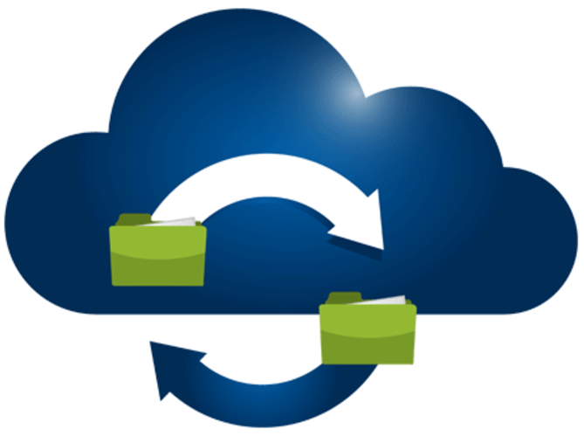
Key Data Archival Use Cases
Data Archival Need |
Data Archival Strategy |
App Exchange Products |
Demo |
1
Data modified on or before a particular date to be archived
2
Metadata for each archival to be stored in the archival database
3
Data Archival for a specific Business Unit or user.
4
Restore records based on certain criteria

Slide 9



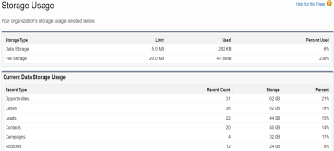
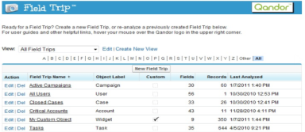
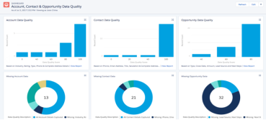
Cloud Data Archival – Tools
Data Archival Need |
Data Archival Strategy |
App Exchange Products |
Demo |
Secure, automated, Salesforce data backups, sophisticated data compare and restore tools
CloudAlly’s secure, automated daily backups of Salesforce, including Chatter, attachments, objects and metadata to unlimited Amazon S3 Storage provides an archive of your online data enabling you to view, export/ restore/ migrate data.
Replicator automatically copies your Salesforce data to your back office, allowing you to safely archive or distribute that data throughout your organization.
Asdasdasd
for disaster recovery, and replication for sandbox testing. Easy setup, unlimited storage.
Go to Setup >> Data >> Storage Usage to check your current utilization and your usage split across objects.
This utility lets you analyze the fields of any object, including what percentage of the records (or a subset of your records) have that field populated.
Leveraging custom formula fields on many of the standard objects to record data quality and record completeness, the formulas are then depicted through dashboards to identify deficiencies in record data.
AppExchange – Data Quality Analysis Dashboard
AppExchange – Field Trip
Storage Usage in Salesforce

Slide 10
Data Archival Approaches

Slide 11





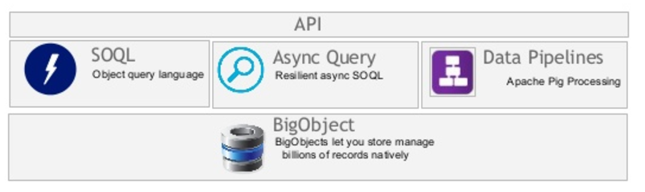
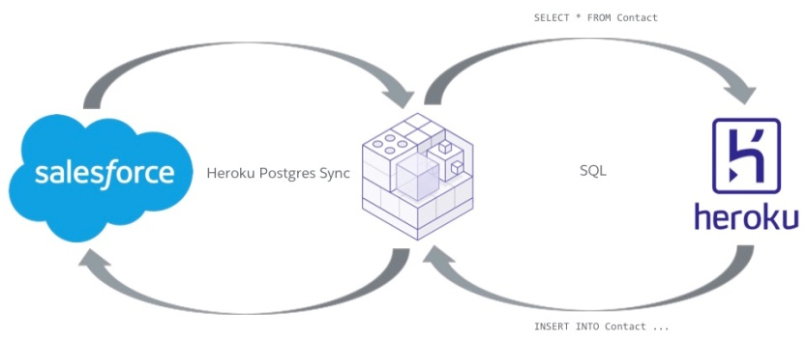
Cloud Data Archival – Solutions
Data Archival Need |
Data Archival Strategy |
App Exchange Products |
Demo |
API
API
Enterprise DB On-Premises / Amazon S3 Server
Salesforce API/ Lightening Connect
Firewall
Lightning Connect
Lightning Connect
Middleware
Enterprise DB On-Premises / Amazon S3 Server
BigObject
Heroku Connect &
Other Custom Solutions..

Slide 12

Archiving Data – Salesforce APIs
Data Archival Need |
Data Archival Strategy |
App Exchange Products |
Demo |
Salesforce APIs can be leveraged to move data from Salesforce Org to another Org or to some other Enterprise software/databases or Amazon S3 Servers.
This option is beneficial when an enterprise software / database already exists for critical data backup. Works well for customers with a data warehouse in place or any other BI system.
Should be considered as an option if speed is a requirement and if there are more than a million records to process.
Data Archived to the Enterprise Database can be pulled back to Salesforce by setting up External Objects using Lightning Connect. These externally archived data can then be updated, deleted, created as an when needed.
API
API
Lightning Connect
Firewall
Lightning Connect
Enterprise Database/Amazon S3 Server
Limitations :
Salesforce has governor limits for all APIs.
Customer has to develop functionality/programs to replicate / backup data & metadata using APIs.
Lightning Connect comes at a cost.

Slide 13
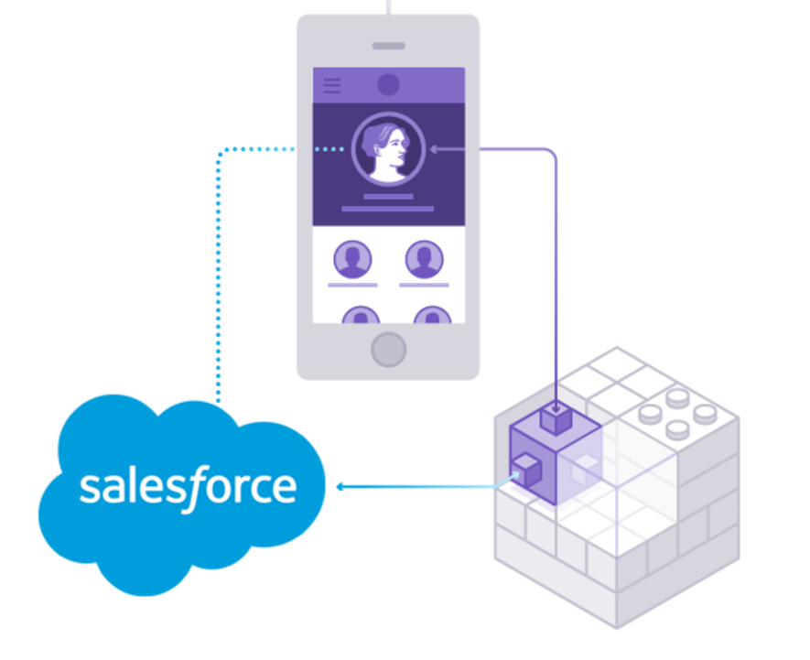
Archiving Data – Heroku Connect
Data Archival Need |
Data Archival Strategy |
App Exchange Products |
Demo |
Heroku Connect makes it easy for you to build Heroku apps that share data with Salesforce.
Using bi-directional synchronization between Salesforce and Heroku Postgres, Heroku Connect unifies the data in your Postgres database with the contacts, accounts and other custom objects in the Salesforce database.
Simple Point & Click configuration gets the service up and running in minutes.
With Heroku External Objects, app data, product data, customer data, any data in Heroku Postgres can be integrated into Salesforce with a simple point and click configuration.
Does not count against API limits so this is a good option for high velocity changes.
Good option for consolidating data across multiple Salesforce Orgs for analytics, backup etc.
Limitations :
Heroku Connect is a paid service.
It does not support on the fly transformations.

Slide 14
Archiving Data – BigObject
Data Archival Need |
Data Archival Strategy |
App Exchange Products |
Demo |
BigObjects let you store and manage very large amounts of data at scale on the Salesforce platform.
The BigObjects feature initially targets the following use cases.
Customer 360—Store point-of-sale data, orders and line items, guest relationship data, and guest interactions in Big Objects and then process and correlate that data with your core CRM data.
Data archive—Orchestrate records from production storage to an archival data store, such as for FINRA compliance, without moving the data out of Salesforce’s trusted platforms.
Data lake—Store massive data in its native format until you need it.
Email event ingest—Preserve email for customer interaction history, segmentation, and sentiment analysis.
Limitations :
BigObject is a pilot program and requires agreement to specific T&C. Companies need to contact their Salesforce Account Executive to be a part of the pilot.
Salesforce cannot guarantee general availability for the pilot program within any particular time frame or at all.

Slide 15
Data Archival for Bayer

Slide 16

High Level Architecture of Archival Solution
Bayer Enterprise architecture for Salesforce includes SQL Server and Talend as integration middleware.
Talend leveraged to built a integration layer & fetch data from Salesforce and push it to SQL Server – IN-Situ/ On-Premises & back
Two way data movement, for retrieval from IN-Situ Data Archival Repository. Salesforce >> Talend >> SQL Server & back
Key Advantage:
No additional licenses, leverage preferred technology platform already in the eco-system.
Leverage this architecture to extend it also as a backup strategy, so that two use cases can be achieved with the same deployment.
Enterprise DB On-Premises / Amazon S3 Server

Slide 17
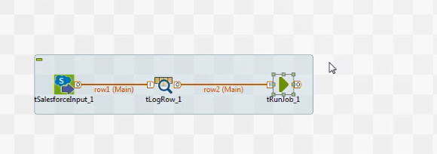
Talend Executable
Data Archival Need |
Data Archival Strategy |
App Exchange Products |
Demo |
Talend is used as the ETL of choice for Archival, as Bayer has licenses for the same.
The Talend solution would be deployed as an executable which can be called on-demand, can be scheduled as a batch job, or can also be called from the Angular app.

Slide 18
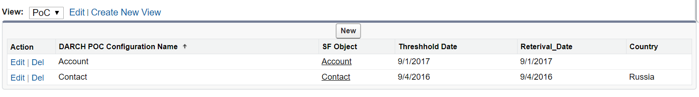
Archival Settings Configuration in Salesforce
Data Archival Need |
Data Archival Strategy |
App Exchange Products |
Demo |
Archival Settings are configured as Custom Metadata types in Salesforce, which would allow Admin personnel to easily control the archival data threshold.
Administrator can control the Archival Date, Restore Date and also the Country (in case of a multi-country org).
The benefit of this is that Salesforce would be a single point solution for the entire archival configuration.

Slide 19
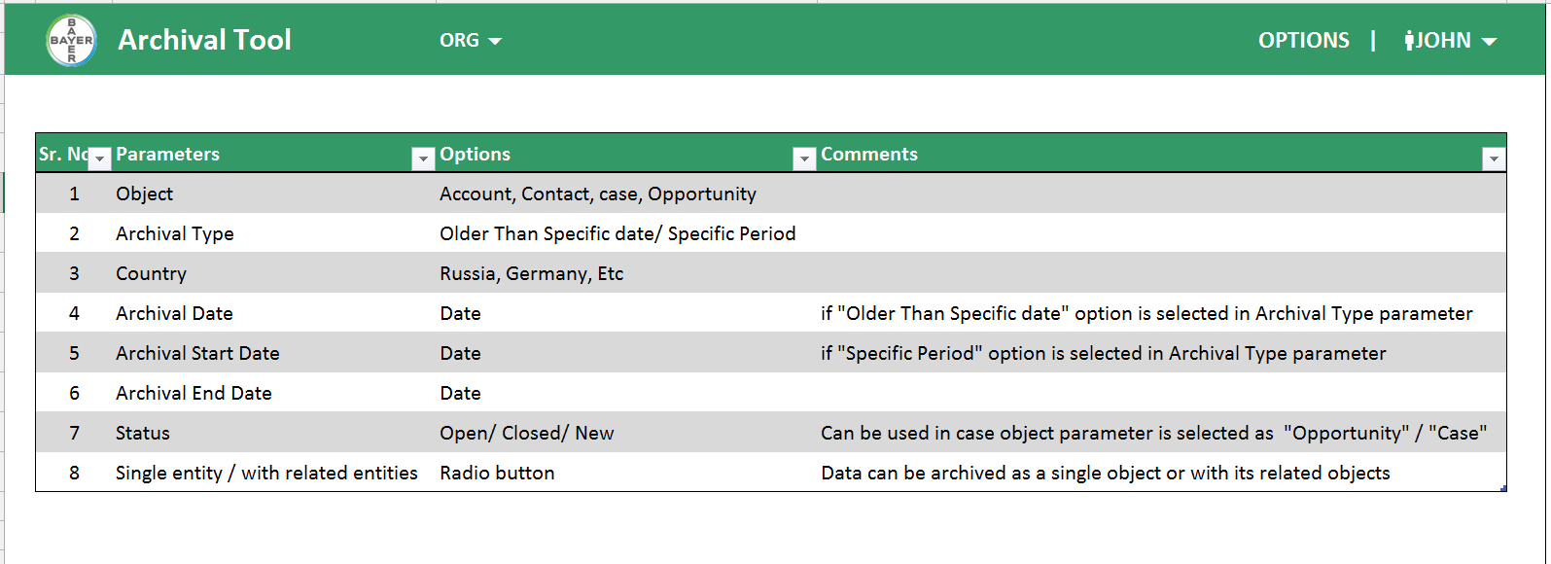
Archival Settings Configuration in Standalone app
Data Archival Need |
Data Archival Strategy |
App Exchange Products |
Demo |
Archival Settings can also be configured using a standalone Angular JS app.
Once configured the app can directly call the Talend executable.
The benefit of this, is that the Administrator can have the entire program in one place.

Slide 20
Q&A

